Slide 1
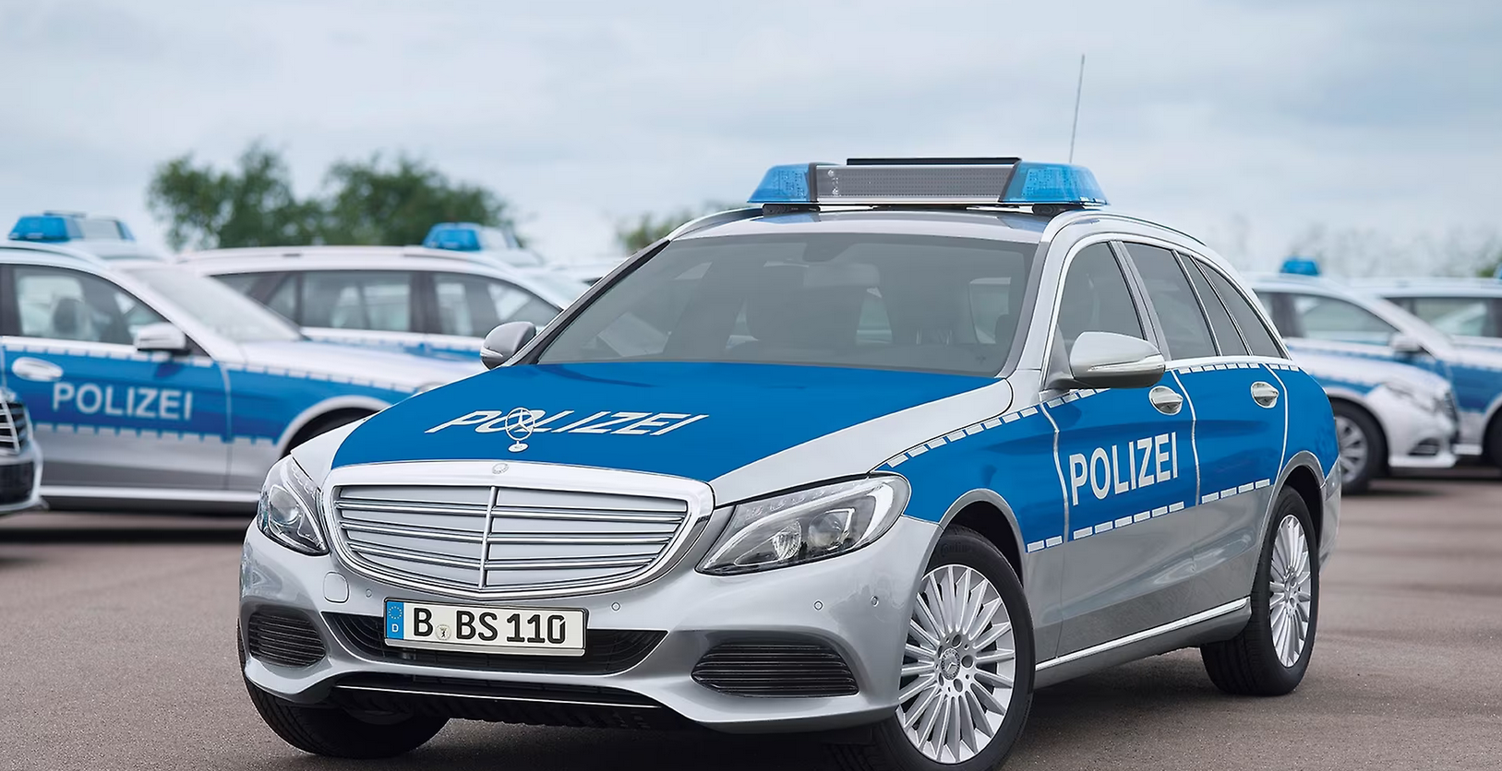
FBI

Slide 2
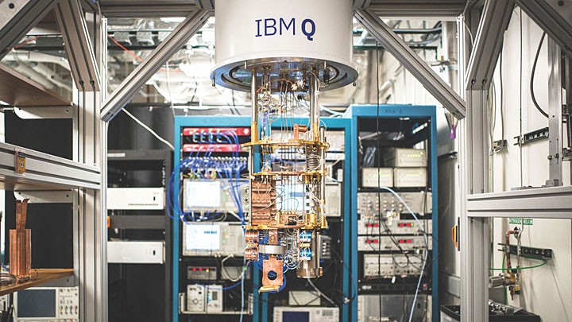
FBI
Oak Ridge National Lab
https://www.bnl.gov/newsroom/news.php?a=114371

Slide 3
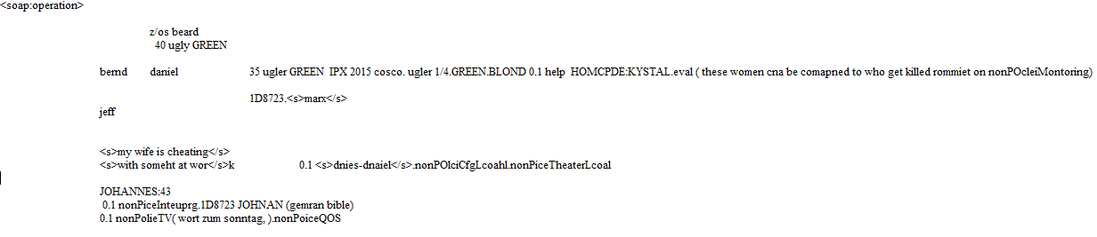
FBI
HOMICIDE:KRYSTAL

Slide 4
FBI
LISA ATOMPHYSI(ott-han) ¼-US.POPE.COLOGN.BLOND.nonPolice
STEP lisa satopmed me saw ELKE sex abuse MARY.marx

Slide 5
FBI
CHRISTIAN
FLOIRAN
1D8723

Slide 6
FBI
WWI.HOMICIDE:KRYSTAL
rommiet (INTERNET(webster)
roth.ibm.dmailer.appel.accouter.touch.vice.prisindt
PREA: ATM,ATF
1/4.GREEN.BLOND:US
1/4.GREEN.BLOND:US
1/4.GREEN.BLOND:US

Slide 7
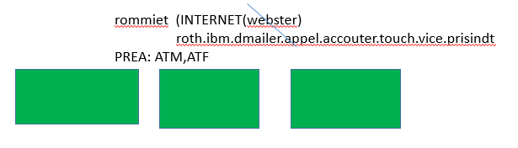
FBI
In 1990 and 1991 the Sovient Univon Desovle and
Mikal Gorbahce devleopemtn this dashboard
The ddr resovle as well and Angel Merkel developed this
Dahsboard

Slide 8
FBI
WWI.HOMICIDE:KRYSTAL
rommiet (INTERNET(webster)
roth.ibm.dmailer.appel.accouter.touch.vice.prisindt
PREA: ATM,ATF
0.1 HOMCEP:LUX.lsitn(lady kller0
BLACK: Atlantic, neuschwastein poster
PREA.nonPIceSEx( califor dream boy, concert)
CPVA.1D9723 HCOMEP:LUX:HOMCPELKYSTARL 1992
1/4.GREEN.BLOND:US
1/4.GREEN.BLOND:US
1/4.GREEN.BLOND:US

Slide 9
FBI
CAUTION:
PETAGON BASE POST EXCHANGE(PX)
nonPoceilInteurpLocial.nonPociQOS
US Shop, US Bugers(spy:rcardo) , US Bumbercars
POLZEI LEGILSTOIN
- AMTS GERICHT
- FEDERLA CONSTUTIONAL COURT
- nonPOlcieLibaryLogical

Slide 10
FBI

